Slide 1
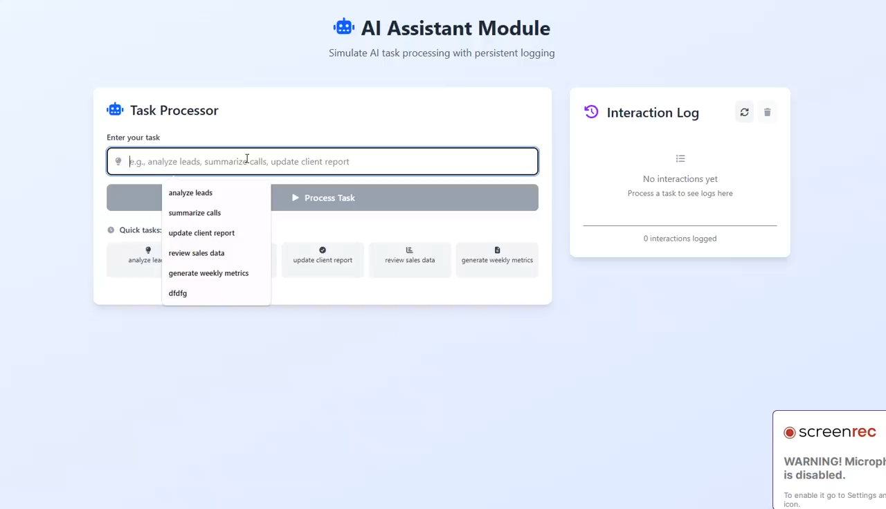
1. AI Test Project Frontend Video

Slide 2
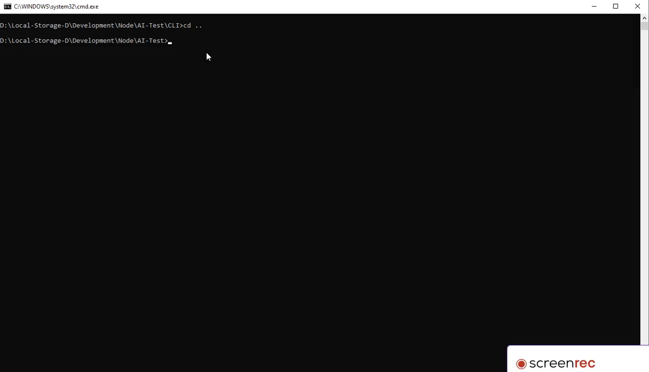
2. AI Test Project CLI Video

